Slide 1
Title: Natural Language Processing (NLP) Project Language Recognition using Naive Bayes Classifier Presented by: Pritha Roy Institute: NSTI(W) Kolkata Course: AIPA Date:7/06/2025

Slide 2
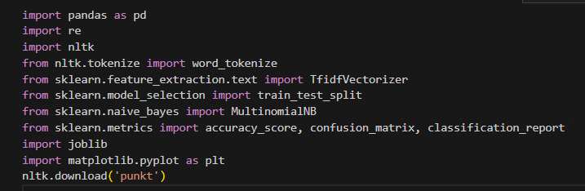
Introduction to NLP
What is NLP?
Natural Language Processing is a branch of AI that helps computers understand, interpret, and generate human language. Applications: Chatbots, Language Translation, Sentiment Analysis.
Libraries Used:

Slide 3
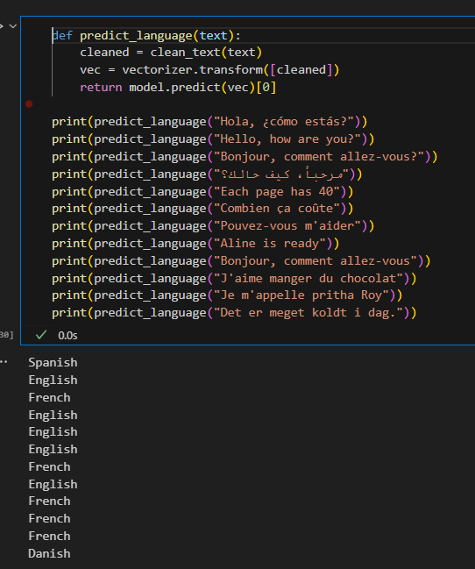
Project Objective
What is the main goal of this project?
To detect the language of a given text using
a Machine Learning algorithm — specifically,
the Multinomial Naive Bayes classifier.
Use Case: Automatic Languages detection.
Languages in Dataset:
English – “How are you?”
Spanish – “¿Cómo estás?”
German – “Wie geht’s dir?”
French – “Comment ça va ?”
Italian – “Come stai?”
Dutch – “Hoe gaat het?”

Slide 4
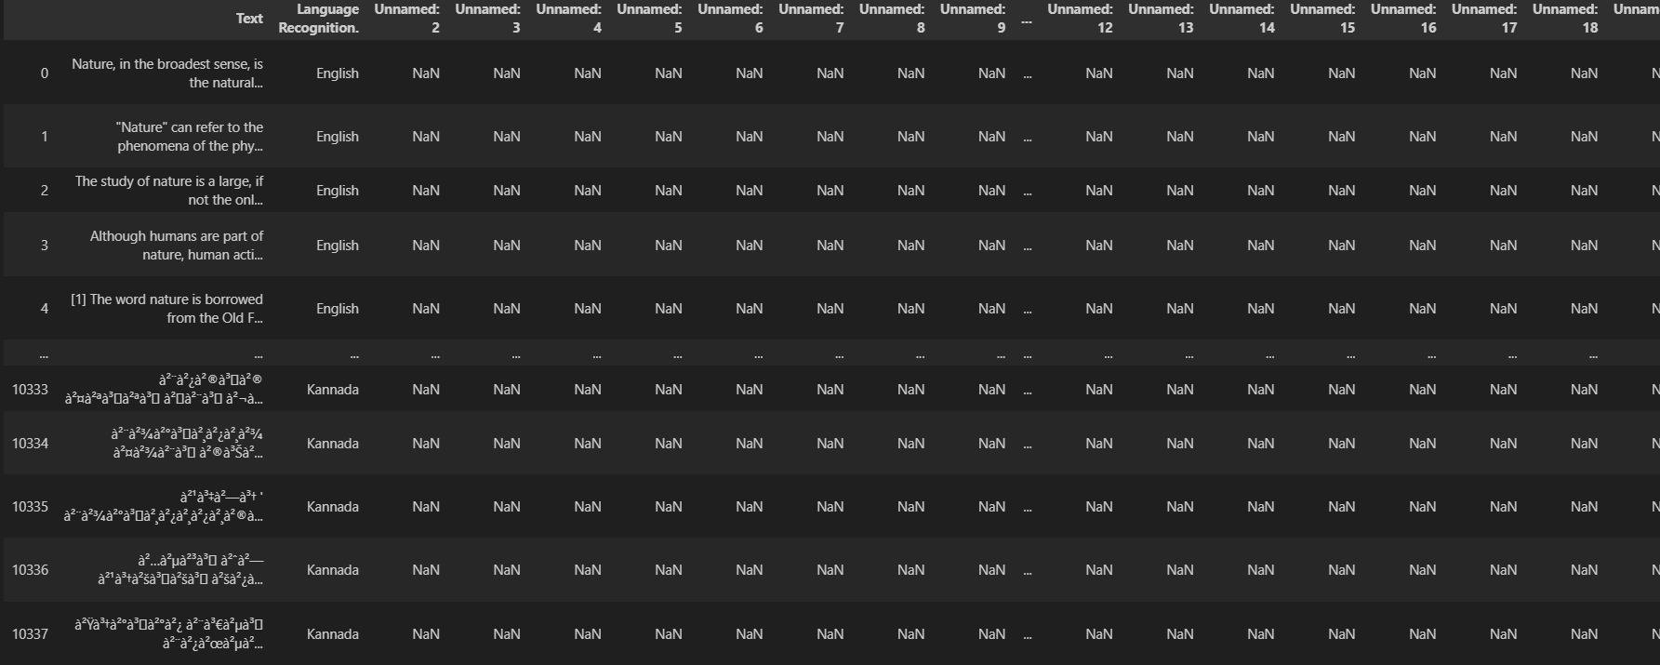
Dataset Details
Q: What dataset is used? A custom or pre-collected dataset with text samples labeled by language. Examples:
‘Bonjour tout le monde’– French
‘Hello world’ – English
‘Hola mundo’ – Spanish etc. Size: ~10338 rows × 22 columns , multiple languages.

Slide 5
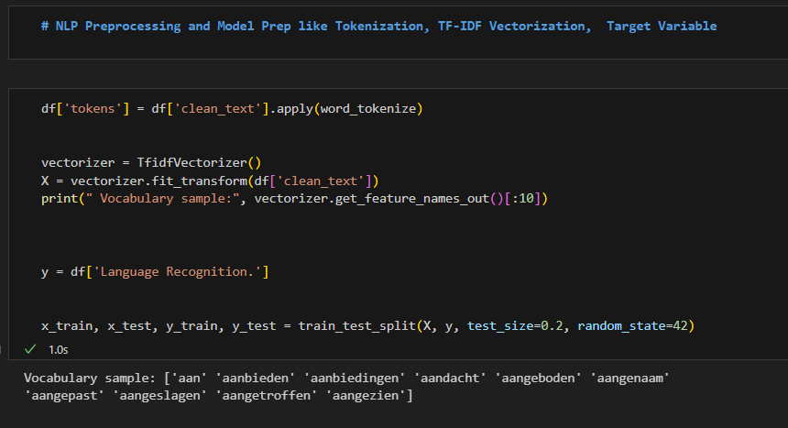
Text Preprocessing
Steps followed: Lowercasing, Tokenization (using NLTK), Removing punctuation, TF-IDF Vectorization for feature extraction

Slide 6
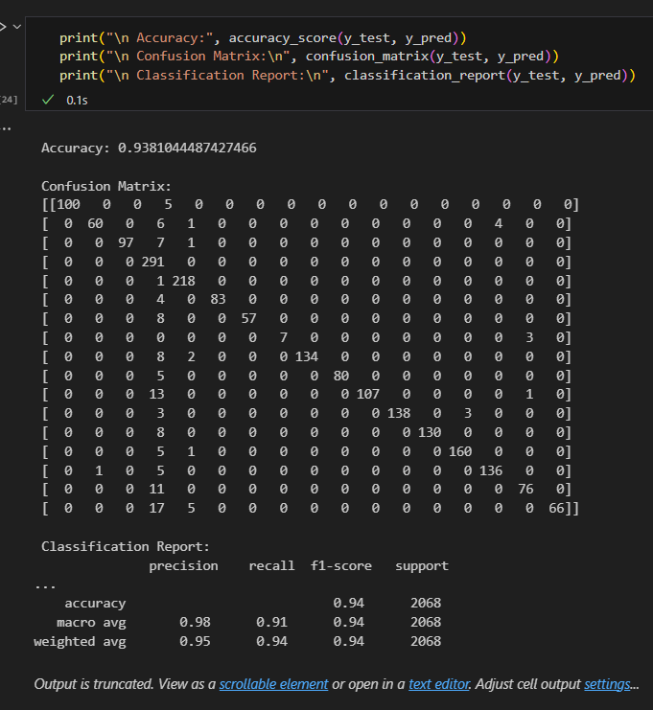
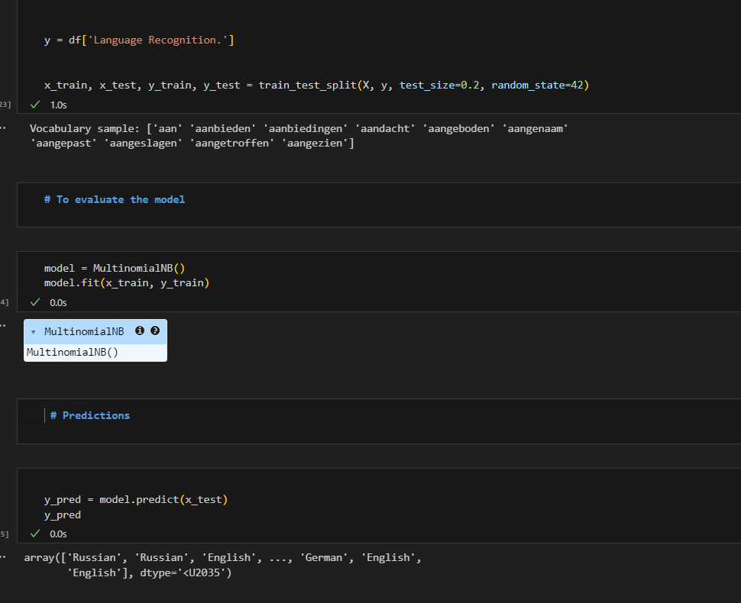
Machine Learning Model
Model Used: Multinomial Naive Bayes
Training/Test Split: 80% training, 20% testing

Slide 7
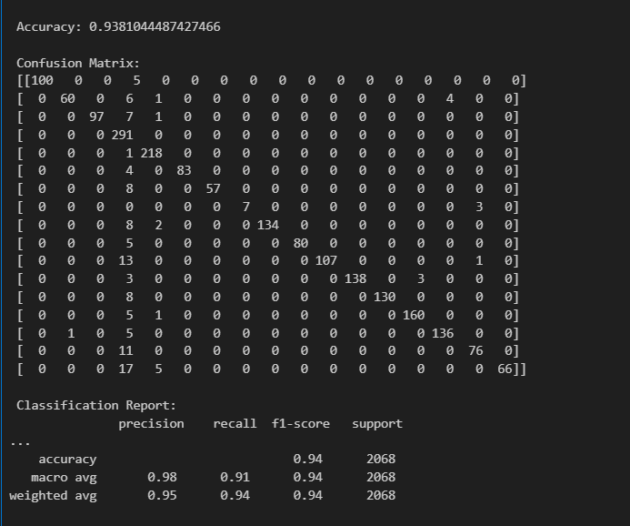
Evaluation Metrics
Accuracy: 0.9381044487427466 Classification Report: Shows precision, recall, F1-score

Slide 8
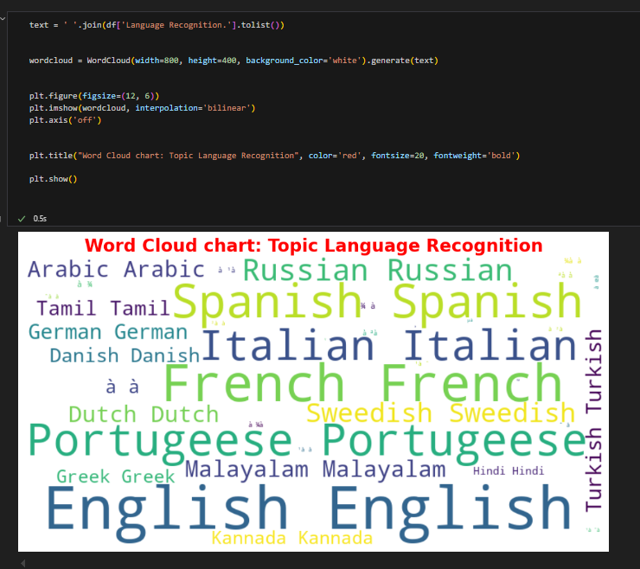
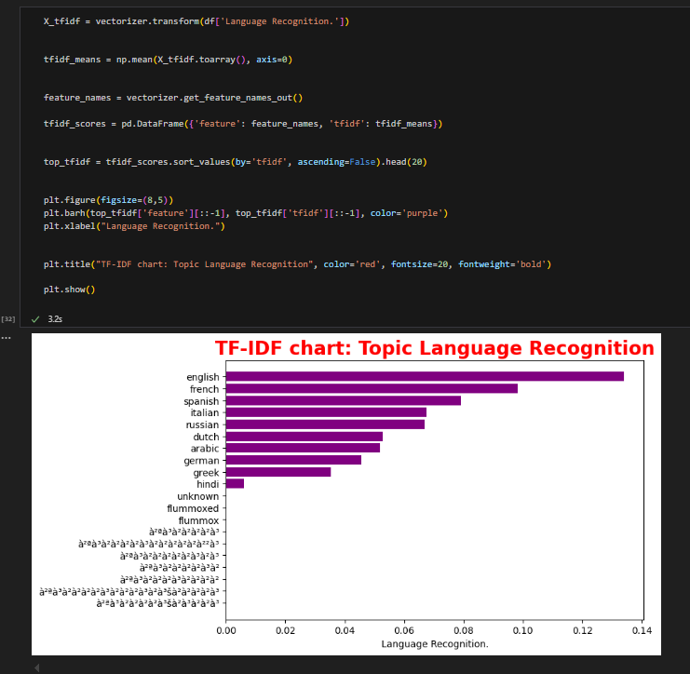
Output:

Slide 9
Conclusion
Learned NLP, preprocessing, and Naive Bayes
Successfully built a Language Detection model
Future work: Add deep learning model like LSTM

Slide 10
Than you

